Slide 1
Soil Structure
Understanding basic pedology

Slide 2
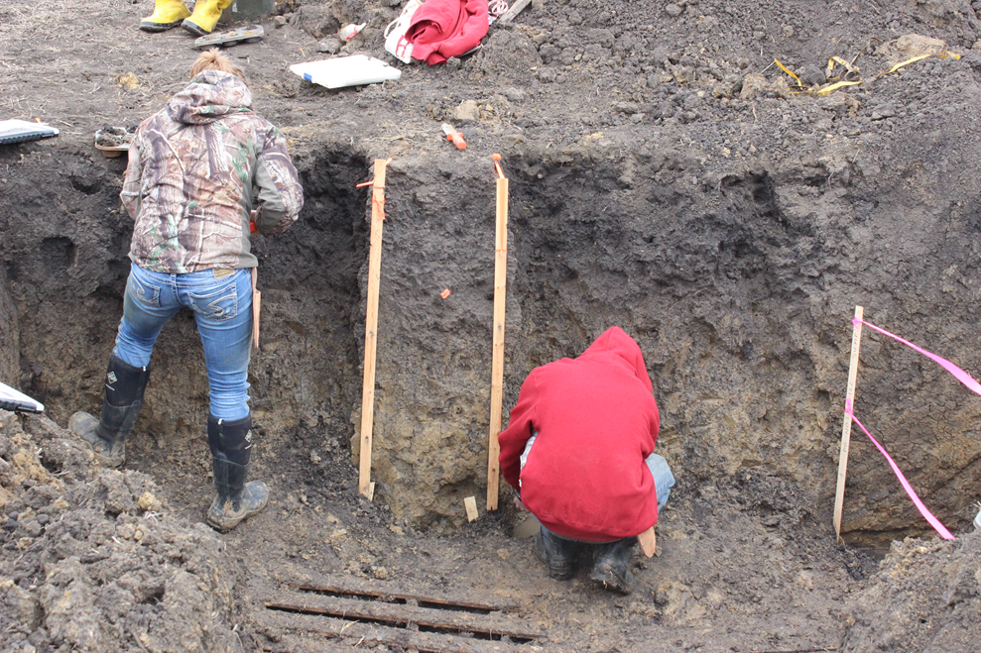
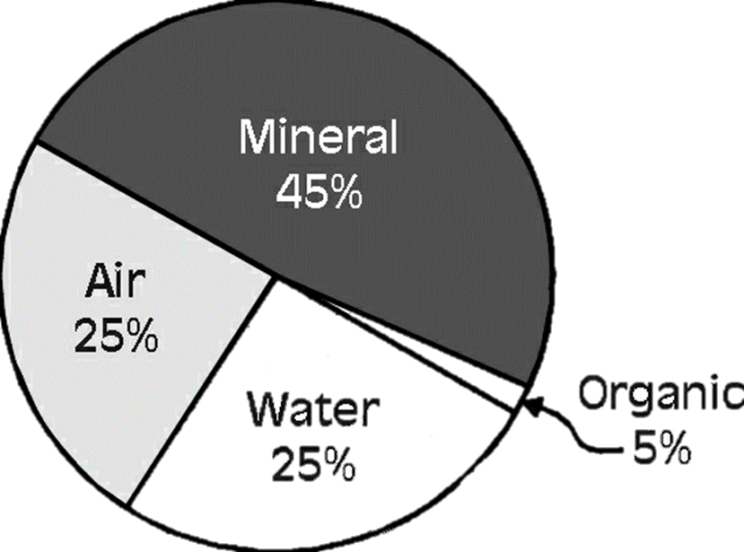
What is Soil?
“The unconsolidated mineral or organic material on the immediate surface of the earth that serves as a natural medium for the growth of land plants.”
--Soil Science Society of America
Composition of soil

Slide 3
Structure Starts with Texture
Soil has three particle sizes:
Sand - .05 mm – 2 mm
Silt - .002 mm – .05 mm
Clay - < .002 mm
Other solids in soil:
Course fragments (includes stones) - > 2 mm
Organic matter (includes plant and animal material)

Slide 4
Textural Triangle
Soils aren’t just sand or silt or clay; usually they are a mix of these.
The textural triangle helps soil scientists understand the properties of a soil based on the percentages present of each particle size
Scientists judge soils by feel and appearance

Slide 5
Properties of Sand
Sand is very well drained
Feels gritty to the touch
Can look sparkly or glittery in soil

Slide 6
Properties of Silt
Silt is moderately well drained
Feels soft, floury, or silky
Looks dull in color

Slide 7
Properties of Clay
Has poor drainage
Because of small particle sizes, the space between particles is very small
Feels sticky
Looks more shiny than silt
Plate-like in chemical structure

Slide 8
Soil Texture Basics
Smaller particles tend to have a higher capability of holding minerals
Clay particles help soils stick together
The larger the particle size, the better the drainage
The naturally occurring soil structure unit is called a ped or aggregate
Virginia Cooperative Extension

Slide 9
Soil Structure Basics
Structure is important because it influences water and air movement through the soil
Size, shape, and strength of peds all influence the overall structure
Vocab:
Micropore: pores small enough that water inside is considered immobile, though partially plant-available
Pores inside peds
Macropore: large pores responsible for downward flow of water through profile
Pores between peds

Slide 10
Types of Structure
University of Hawaii

Slide 11
Granular
Peds in this structure are small and nearly spherical
Water moves well through granular soils
Most common in topsoil

Slide 12
Blocky
More common in subsoils where there is more clay accumulation
Peds can be nearly square, or more angular
If peds are larger, it can slightly impede movement of water

Slide 13
Prismatic
Soil forms pillars and displays prominent vertical cracks
Drainage is poor
More common in subsoils
Columnar structures are similar, but have an additional salt cap at the top, and are more common in arid climates

Slide 14
Platy
Common side effect of compaction in soils
Also found more in forest soils
Impairs water movement

Slide 15
Non-Structure
Single Grained
Massive
Sand at the beach is single grained in structure.
Peds are essentially nonexistent
The opposite of single grained
the soil has formed one or few large aggregates

Slide 16
Good Structure or Bad Structure?
Good Structure
Bad Structure
Large pores
Ideal amount of water movement
Strong peds
Helps plant roots obtain the right amount of water, air, and nutrients
Small pores
Inhibited water movement
Weak or nonexistent peds
Inhibits water, air, and/or nutrient uptake in plants

Slide 17
Is structure changeable?
Soil compaction crushes peds and deteriorates soil structure
Too much tillage can degrade ped formation
Some tillage, and the incorporation of organic material and root systems can help repair soil damage
Agriculture Victoria, Victoria State Government

Slide 18
Observe your samples!
Analyze what you see in your soil and try to decide what structure type it displays.

Slide 19
Now, test for soil texture!
This is called the ribbon test.
Take a ped in the palm of your hand
Add water until it is about putty consistency
Push the soil between your thumb and forefinger to make a “ribbon”
Make as many ribbons as possible with your sample
North Dakota State University

Slide 20
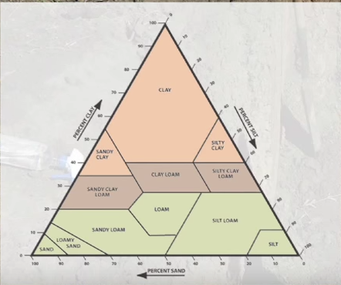
How long was the ribbon?
Long: greater than 2”
Moderate: 1-2”
Short: less than 1”

Slide 21
Now, take a subsample!
Look more closely at the sample.
Is it gritty or glittery?
That means it has more sand content
Is it soft, dull, or floury?
That means it has more silt content
Is it neither?
Then it may be in between!
Use these clues to choose a textural group based on these characteristics
UC Davis

